Slide 1
New Radical MXL2 Config
Rod Bender
Mobile +61 418 509 692
Water Temp (LED 1)
Blue = Water Temp Too Low
Green = Water Temp OK
Red Flashing + “High Water Temp” Message on Red Screen = Water Temp Too High
Yellow at same time as LED6 Red + “ECU Trip-Water Temp” Message on Red Screen = ECU Trip for high Water Temp
Oil Temp (LED 4)
Blue = Oil Temp Too Low
Green = Oil Temp OK
Red Flashing + “High Oil Temp” Message on Red Screen = Oil Temp Too High
[No ECU Trip exists for Oil Temperature High/Low]
Fuel Pressure (LED 2)
Red Flashing + “Low Fuel Pressure” Message on Red Screen = Fuel Pressure Too Low
Green = Fuel Pressure OK
[No Alarms for High Fuel Pressure]
Yellow at same time as LED6 Red + “ECU-Trip-Fuel Press” Message on Red Screen = ECU Trip for Low Fuel Pressure
Oil Pressure (LED 5)
Red Flashing + “Low Oil Press” Message on Red Screen = Oil Pressure Too Low
Green = Oil Temp OK
Yellow Flashing + “High Oil Press” Message on Red Screen = Oil Pressure Too High
Yellow at same time as LED6 Red + “ECU Trip-Oil Press” Message on Red Screen = ECU Trip for Low Oil Pressure
ECU ‘Trip State’ (LED 6)
Green = OK (No ECU Trip Has Occurred)
Red = ECU has decided to Trip Engine Off
When Red LED is showing, there will be another LED showing Yellow. This Yellow LED will indicate exactly which ECU Trip has occurred
ECU Trips Exist for 3 Conditions;
High Water Temperature
Low Oil Pressure
Low Fuel Pressure
Battery Voltage (LED 3)
White = Battery Voltage Too Low
Green = Battery Voltage OK
[No Alarm for Voltage Too High and there is no ECU Trip for Battery Voltage High/Low]

Slide 2
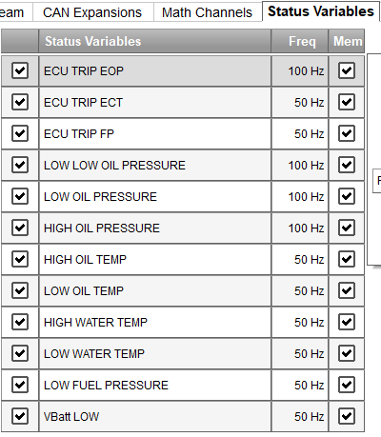
Radical SR3 RSX Dash – AiM MXL2 NEW Configuration with Status Variables
New ‘Status Variables’ set up on the Status Variable Tab

Slide 3
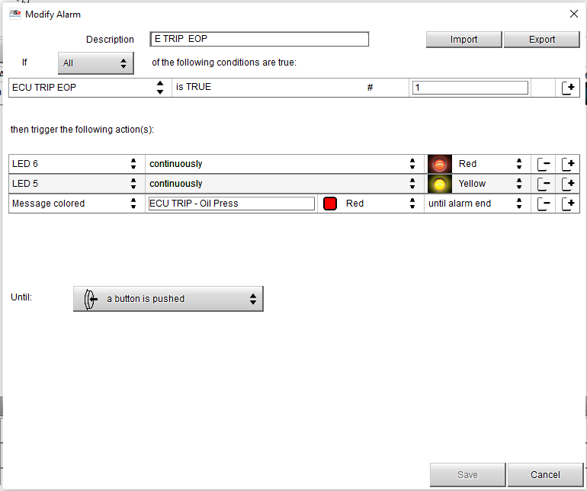
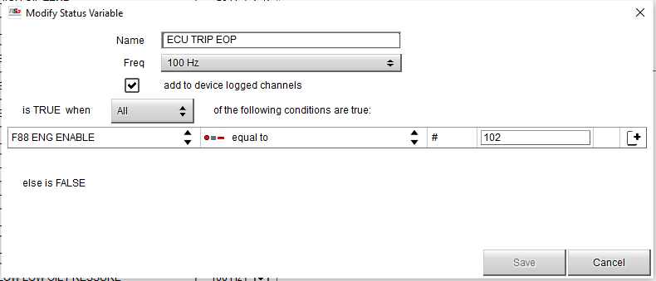
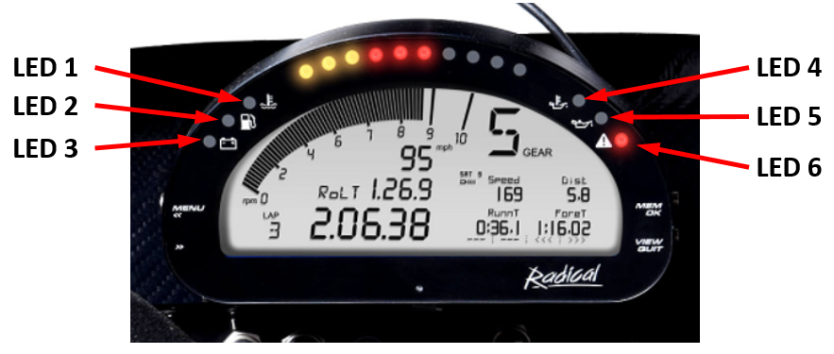
Radical SR3 RSX Dash – AiM MXL2 NEW Configuration with Status Variables

Slide 4
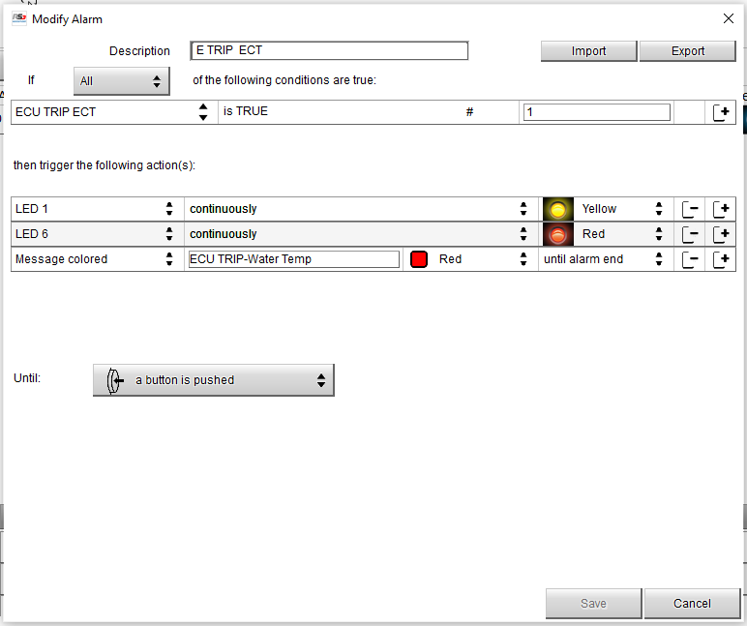
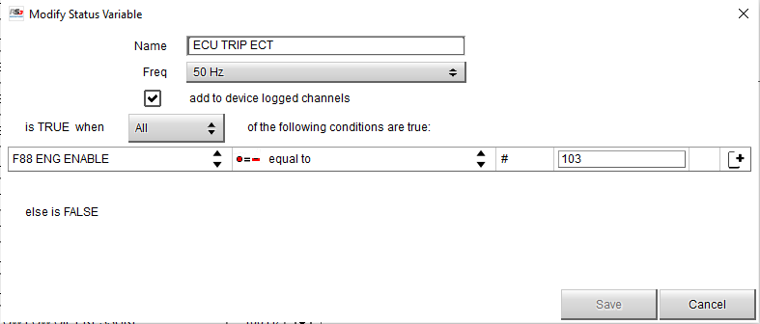
Radical SR3 RSX Dash – AiM MXL2 NEW Configuration with Status Variables

Slide 5
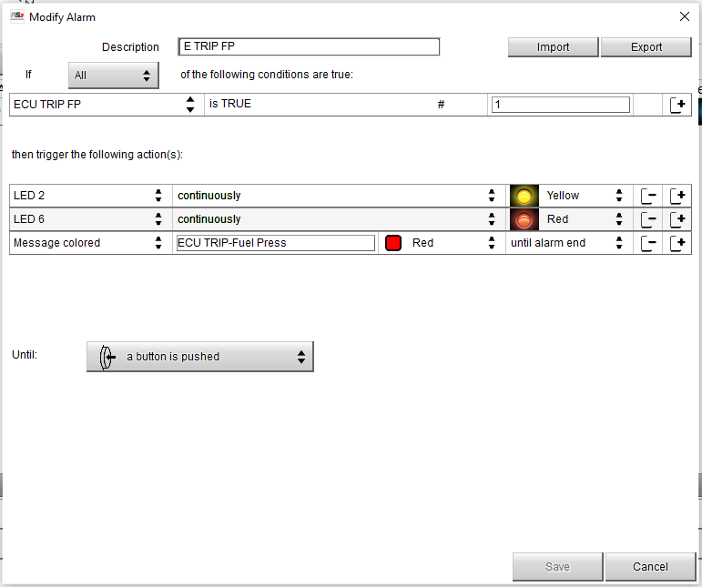
Radical SR3 RSX Dash – AiM MXL2 NEW Configuration with Status Variables

Slide 6
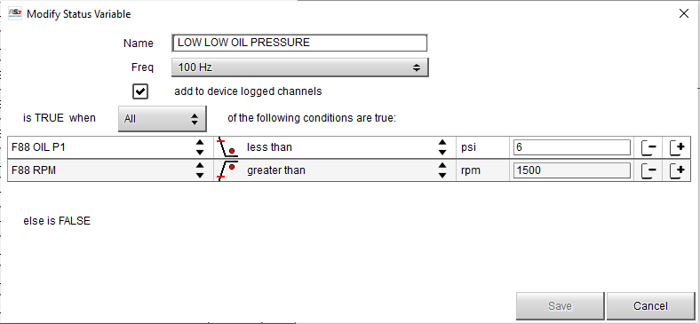
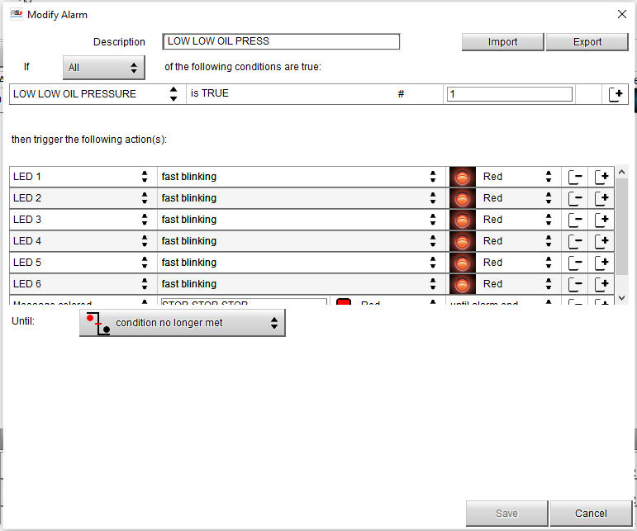
Radical SR3 RSX Dash – AiM MXL2 NEW Configuration with Status Variables

Slide 7
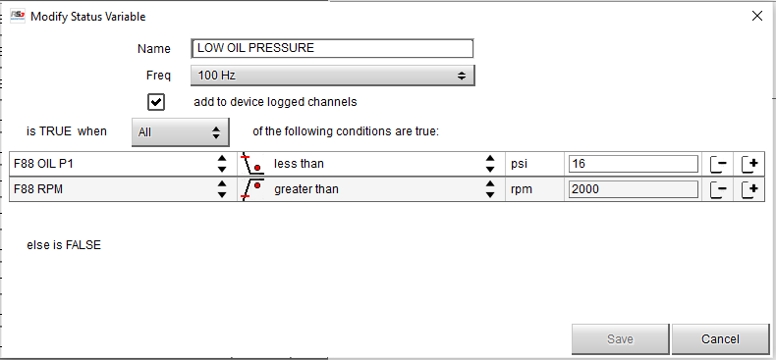
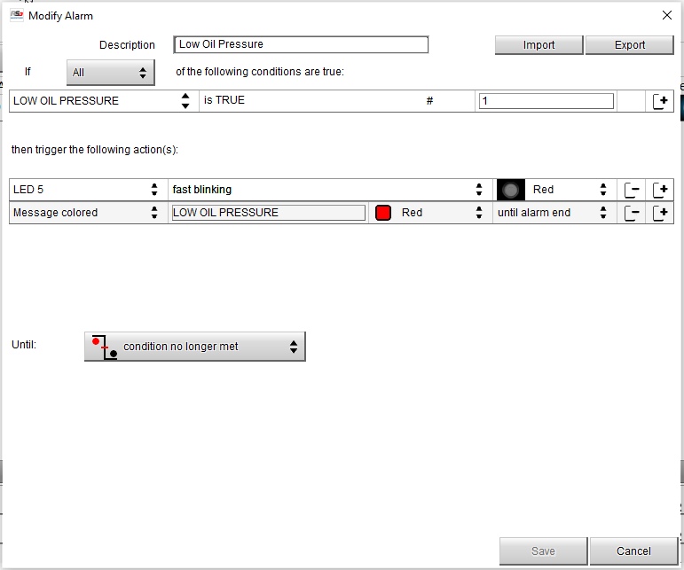
Radical SR3 RSX Dash – AiM MXL2 NEW Configuration with Status Variables

Slide 8
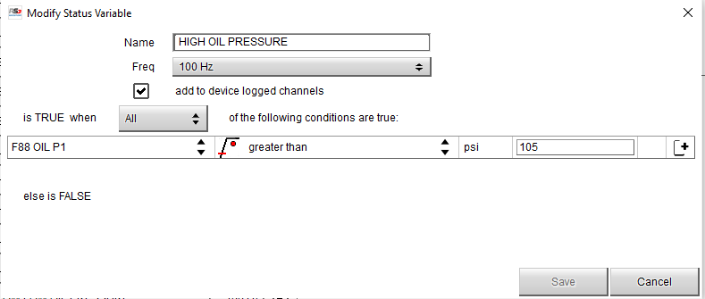
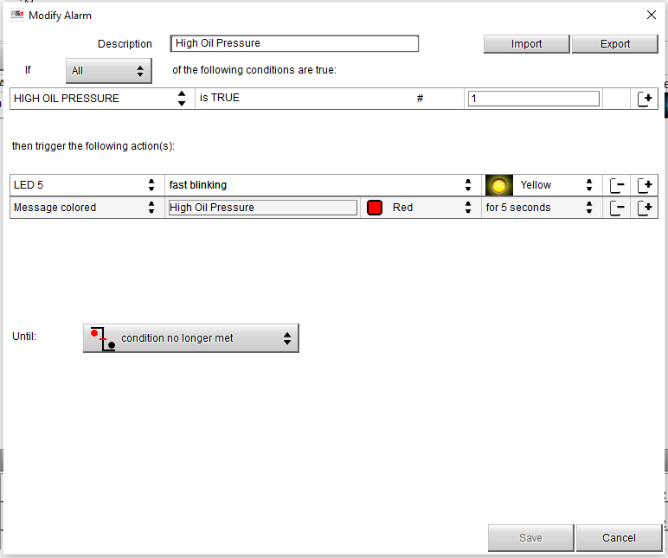
Radical SR3 RSX Dash – AiM MXL2 NEW Configuration with Status Variables

Slide 9
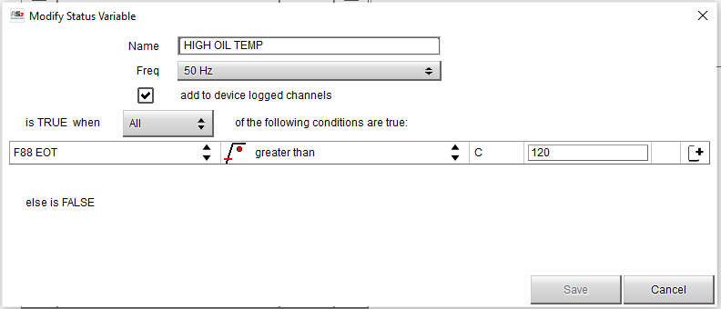
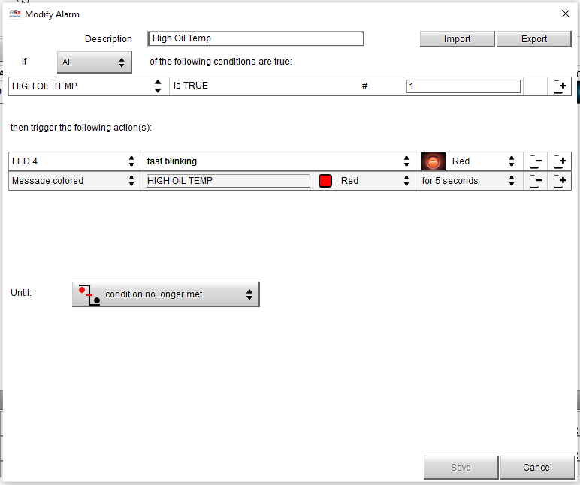
Radical SR3 RSX Dash – AiM MXL2 NEW Configuration with Status Variables

Slide 10
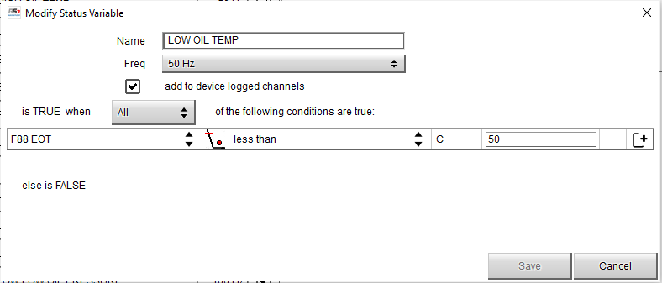
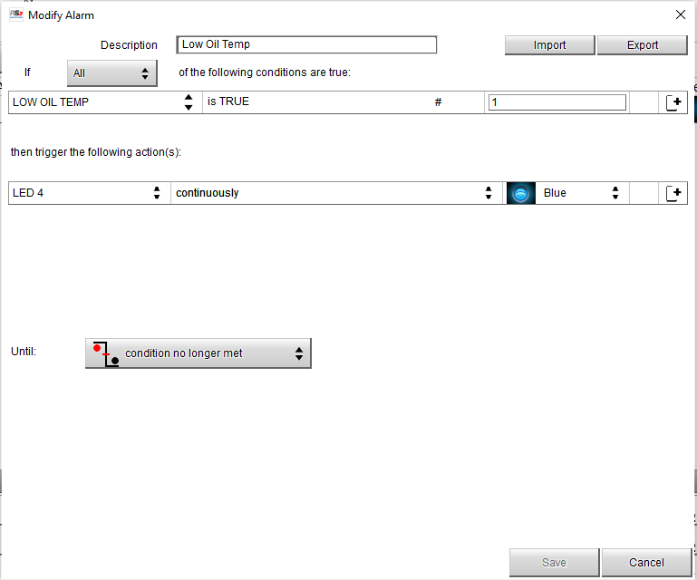
Radical SR3 RSX Dash – AiM MXL2 NEW Configuration with Status Variables

Slide 11
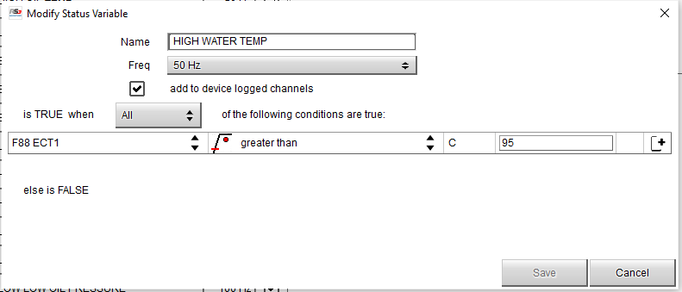
Radical SR3 RSX Dash – AiM MXL2 NEW Configuration with Status Variables

Slide 12
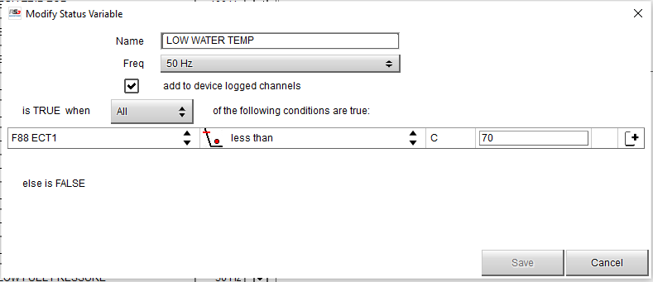
Radical SR3 RSX Dash – AiM MXL2 NEW Configuration with Status Variables

Slide 13
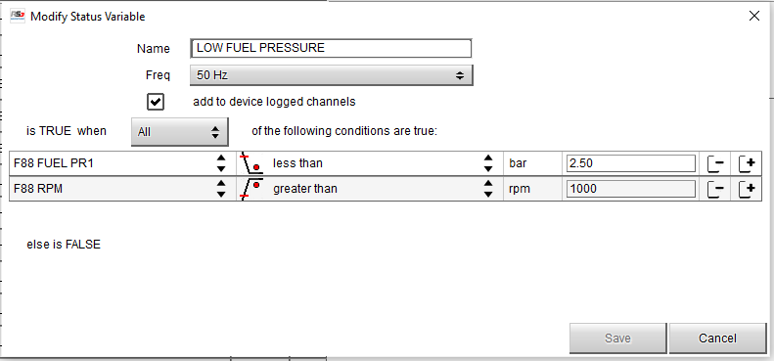
Radical SR3 RSX Dash – AiM MXL2 NEW Configuration with Status Variables

Slide 14
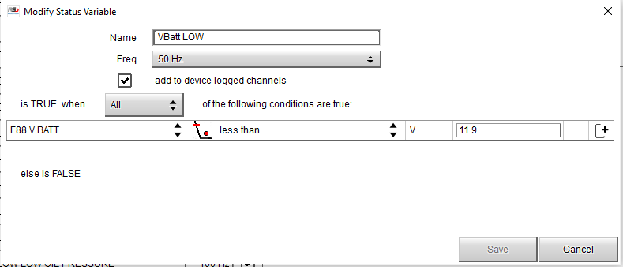
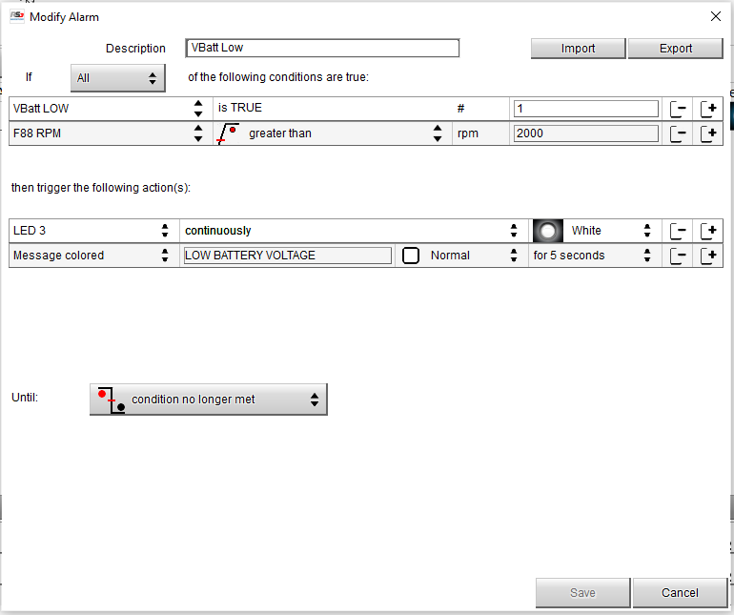
Radical SR3 RSX Dash – AiM MXL2 NEW Configuration with Status Variables

Slide 15
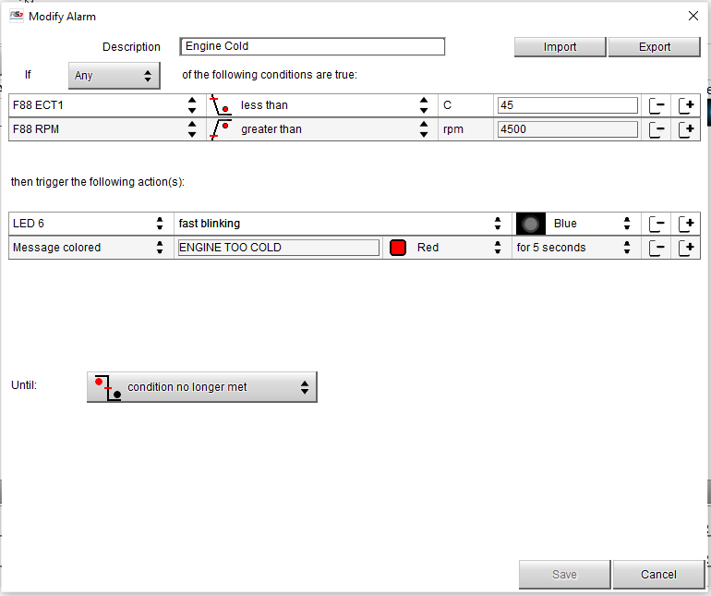
Radical SR3 RSX Dash – AiM MXL2 NEW Configuration with Status Variables
New Alarm – Don’t think this was in original Configuration…

Slide 16
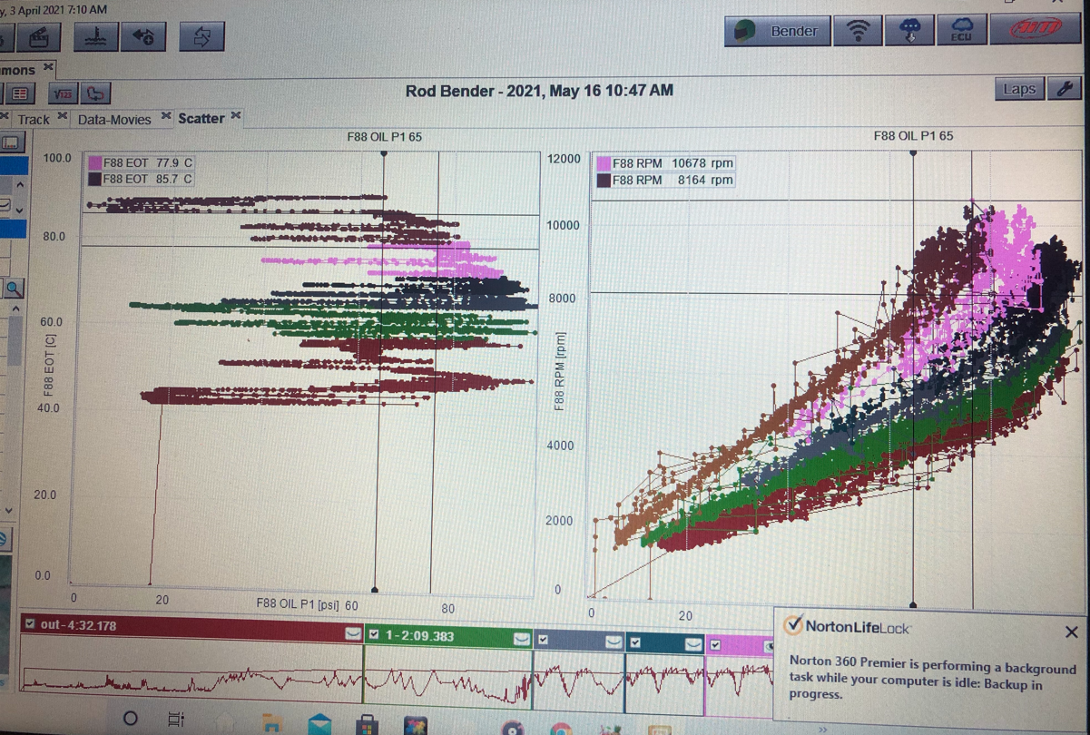
Radical SR3 RSX Dash – AiM MXL2 NEW Configuration with Status Variables
2000 rpm and 16 psi alarm window

Slide 17
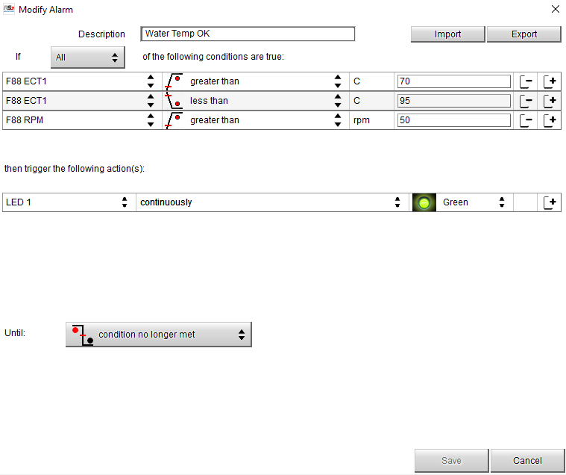
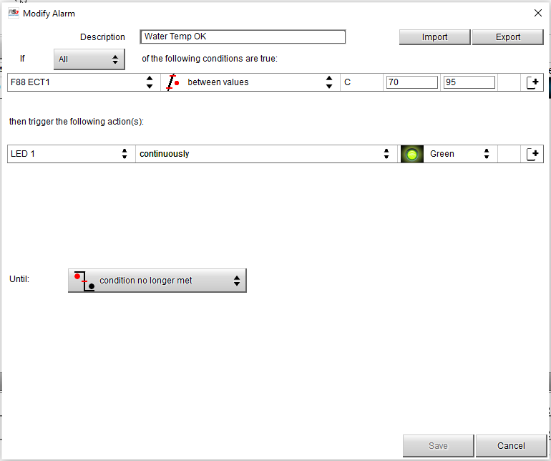
Radical SR3 RSX Dash – AiM MXL2 NEW Configuration with Status Variables
Removed this condition so it still works without the engine running – 2nd July 2021

Slide 18
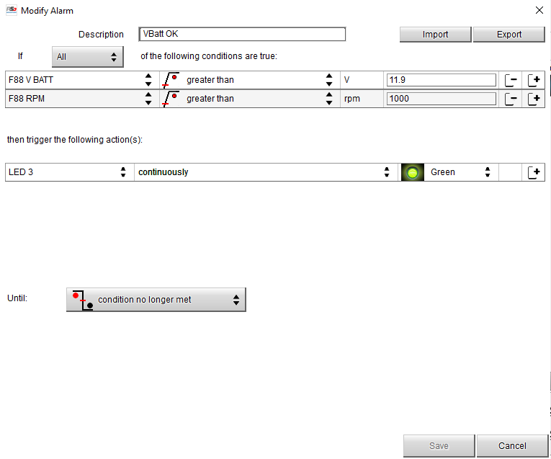
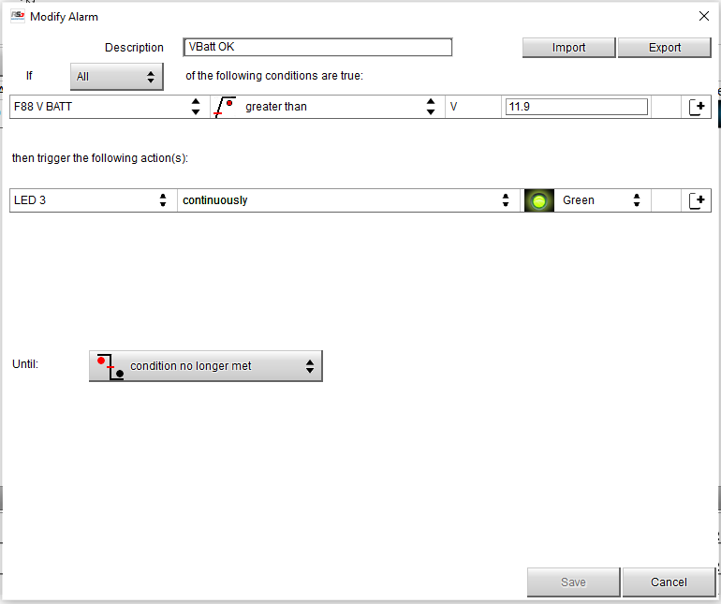
Radical SR3 RSX Dash – AiM MXL2 NEW Configuration with Status Variables
Removed this condition so it still works without the engine running – 2nd July 2021

Slide 19
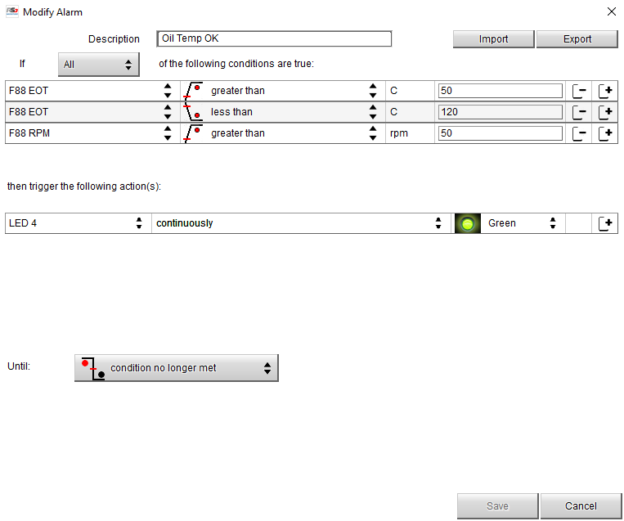
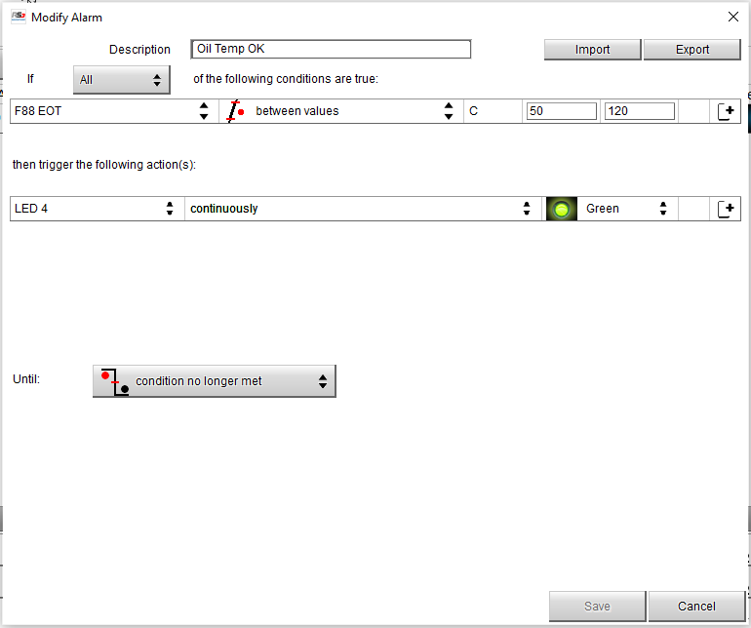
Radical SR3 RSX Dash – AiM MXL2 NEW Configuration with Status Variables
Removed this condition so it still works without the engine running – 2nd July 2021

Slide 20
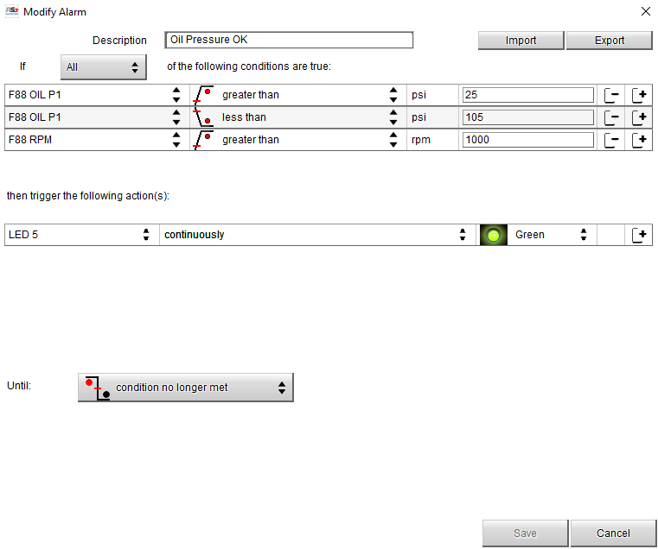
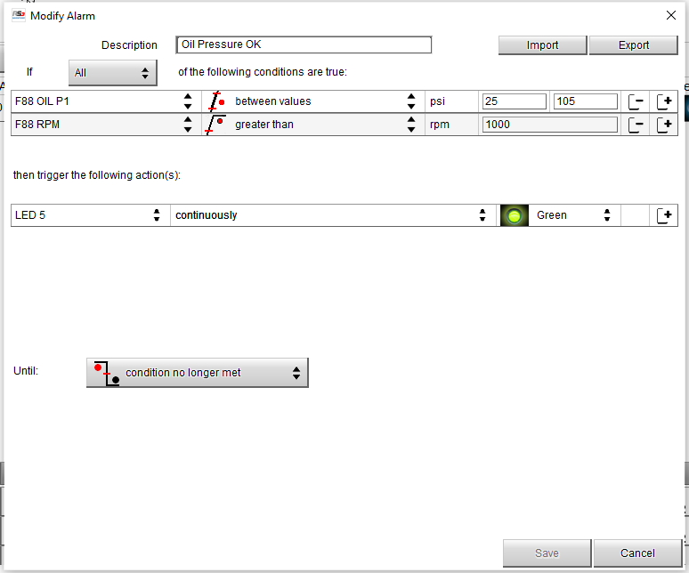
Radical SR3 RSX Dash – AiM MXL2 NEW Configuration with Status Variables

Slide 21
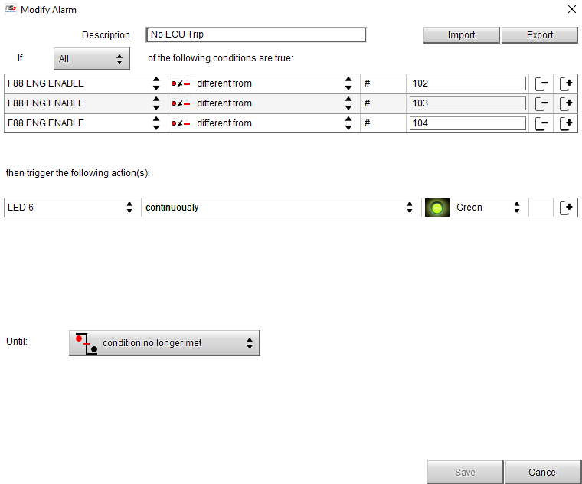
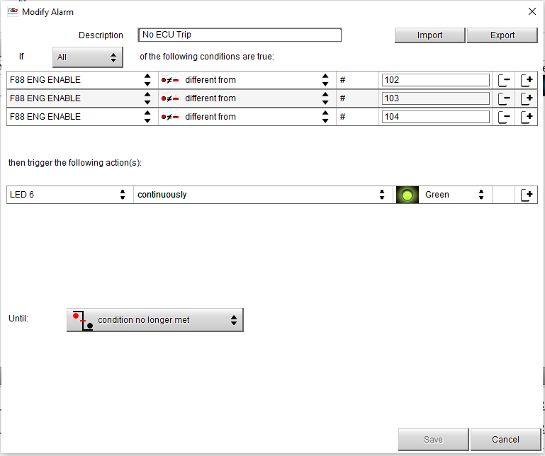
Radical SR3 RSX Dash – AiM MXL2 NEW Configuration with Status Variables

Slide 22
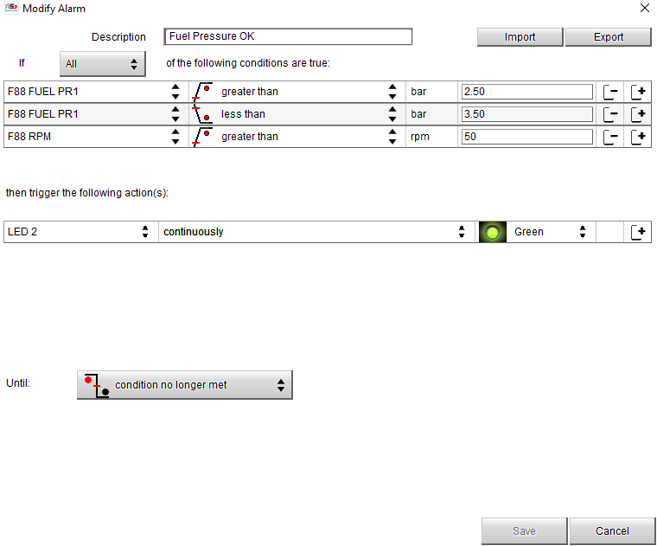
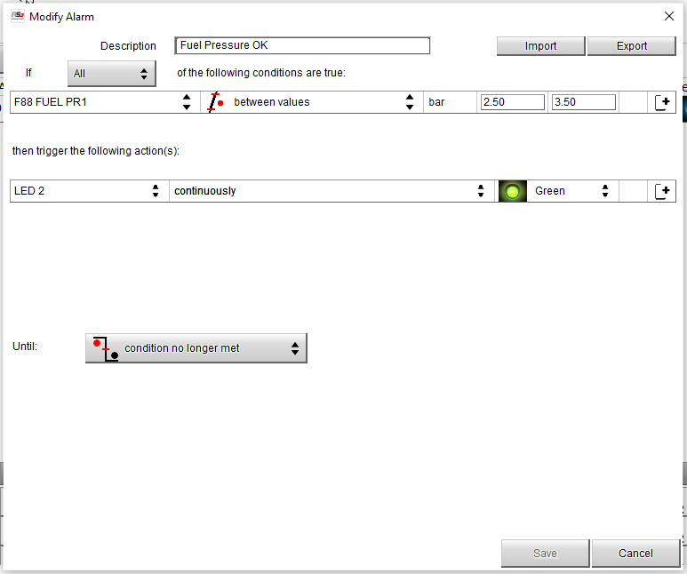
Radical SR3 RSX Dash – AiM MXL2 NEW Configuration with Status Variables
Removed this condition so it still works without the engine running – 2nd July 2021

Slide 23
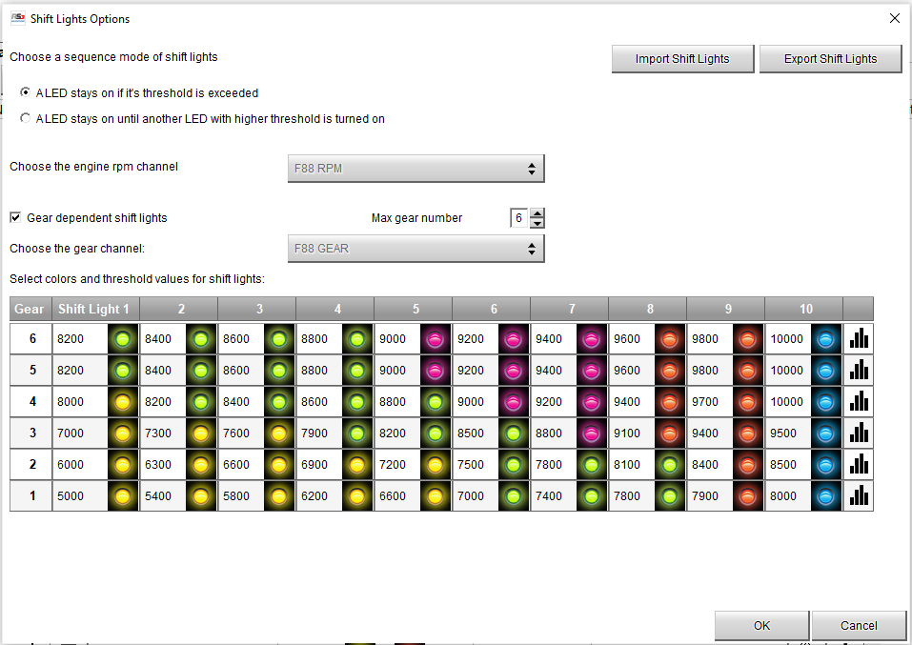
Radical SR3 RSX Dash – AiM MXL2 New Shift Light Configuration (per gear)
Changed to below LED pattern 26th July 2021… but still needs to be transmitted to Logger

Slide 24
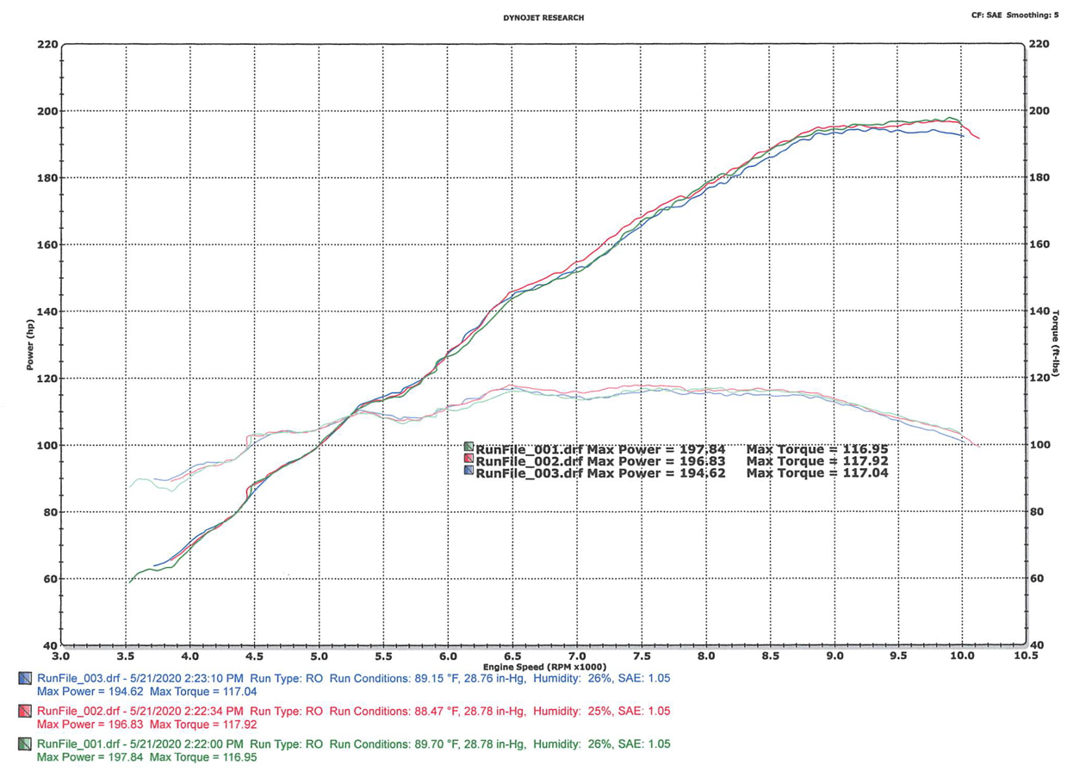
Radical SR3 RPE 1500cc Long Stroke Dyno Chart (wheel hp)

Slide 25
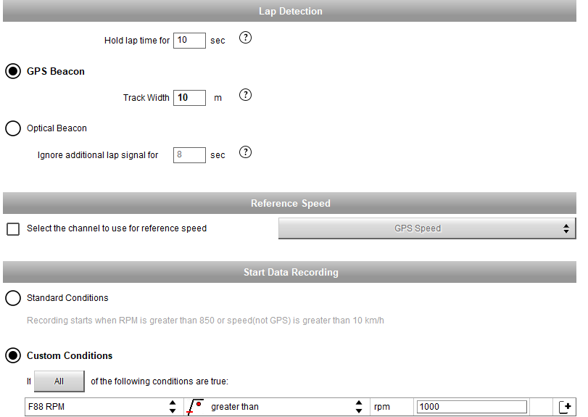
Radical SR3 RSX Dash – AiM MXL2 ‘Parameters’ Configuration

